Slide 1

Fakultas Ilmu Komputer
Learning is the process of acquiring new understanding, knowledge, behaviors, skills, values, attitudes, and preferences.
Default Controller & Method

Slide 2

Defining a Default Controller and Method

Slide 3
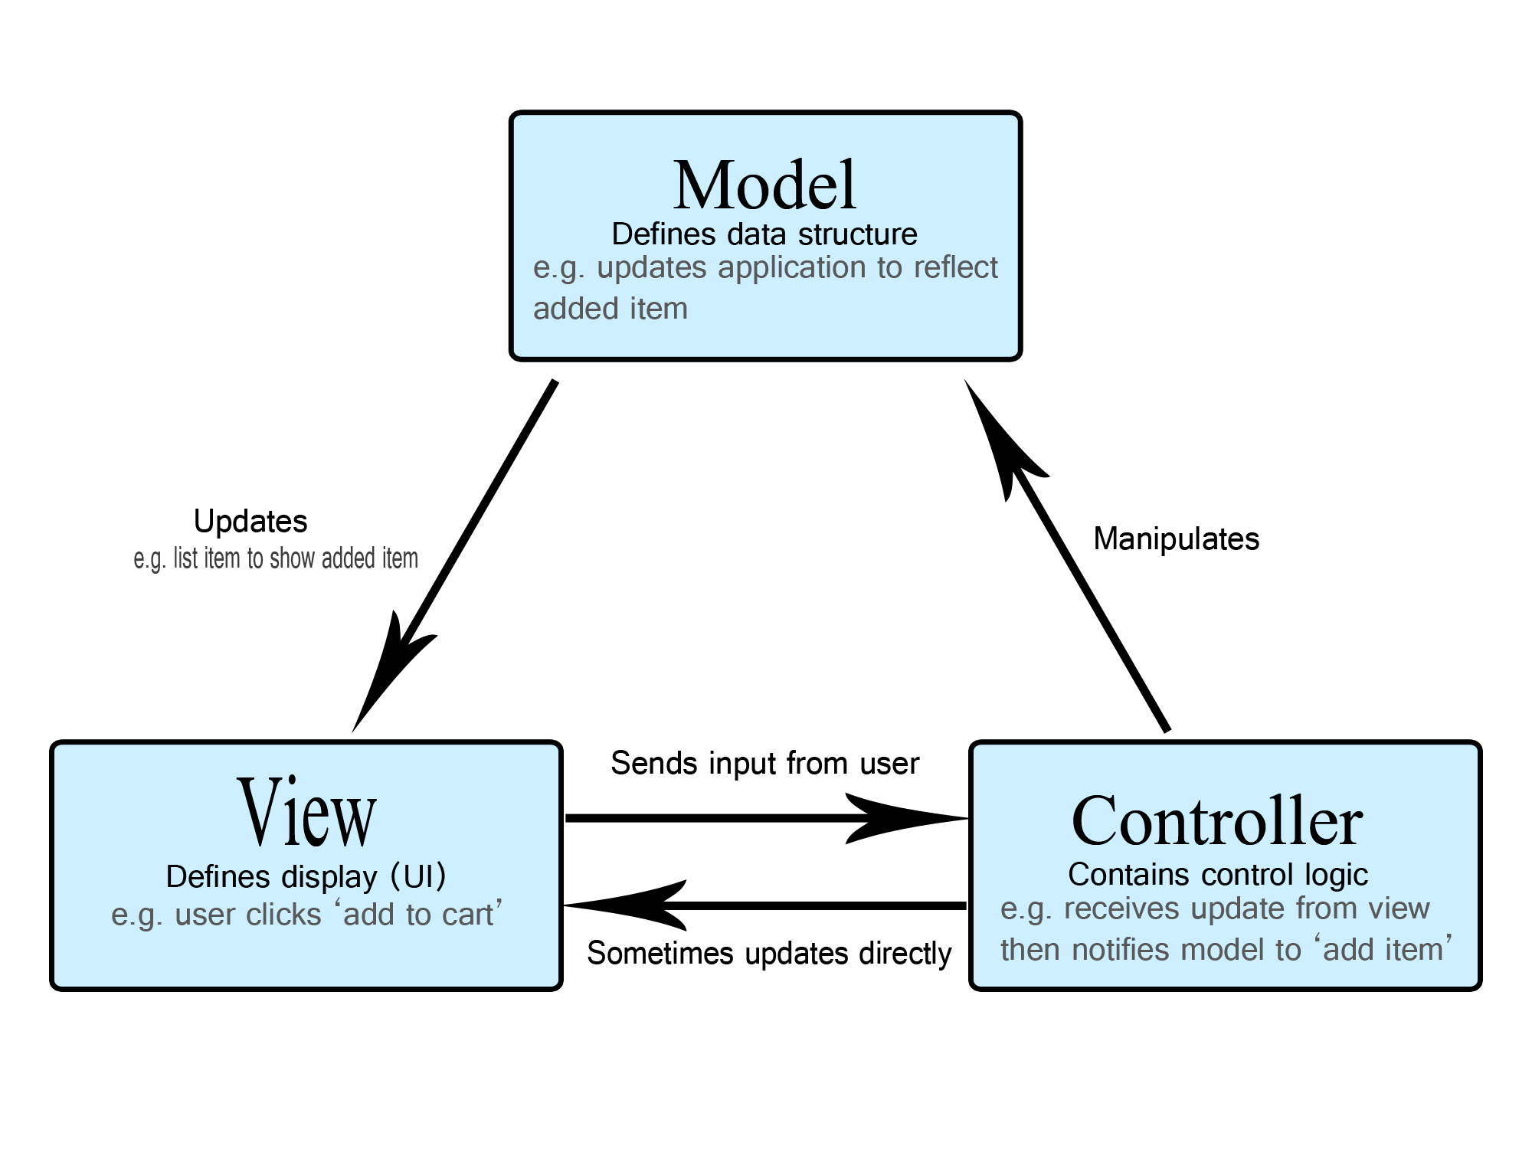
What is a Controller?
Model: The backend that contains all the data logic.
View: The frontend or graphical user interface (GUI).
Controller: The brains of the application that controls how data is displayed.
The Model
The model defines what data the app should contain. If the state of this data changes, then the model will usually notify the view (so the display can change as needed) and sometimes the controller (if different logic is needed to control the updated view).
The View
The view defines how the app's data should be displayed.
The Controller
The controller contains logic that updates the model and/or view in response to input from the users of the app.

Slide 4
What is a Controller?
Controllers are the heart/brain of our application, as they determine how HTTP requests should be handled.
A Controller is simply a class file that is named in a way that can be associated with a URI.

Slide 5
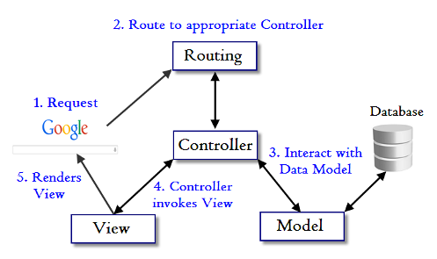
What is a Controller?
Normally a user interacts with the view and performs some action on the screen. A request is generated from the view which is handled by the controller. Controller is actually responsible for handling http request.

Slide 6
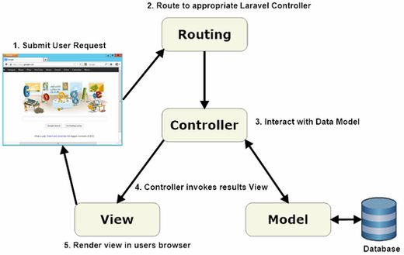
Laravel Controller
MVC URL Routing system allows to create powerful and flexible URLs for the applications.
It provides two functionalities:
Inspect incoming URLs - This functionality manifests when the application receives a client request.
Generate outgoing URLs - This functionality manifests when we render URLs using Url Action in the View.

Slide 7

1 – Some Useful Functions
[We will use later]

Slide 8
1 - PHP file_exists() Function
The file_exists() function checks whether a file or directory exists. Note: The result of this function is cached. Use clearstatcache() to clear the cache.
<?php
// check whether file exists or not
$file_pointer = '/user01/work/gfg.txt';
if (file_exists($file_pointer)) {
echo "The file $file_pointer exists";
}else{
echo "The file $file_pointer does not exists";
}
?>

Slide 9
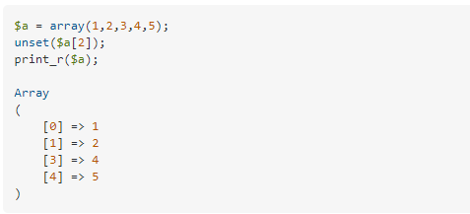
2 - PHP unset() Function
The unset() function destroys a given variable. Here we use unset() function to delete a given element index in array.
Index 2 already removed.

Slide 10
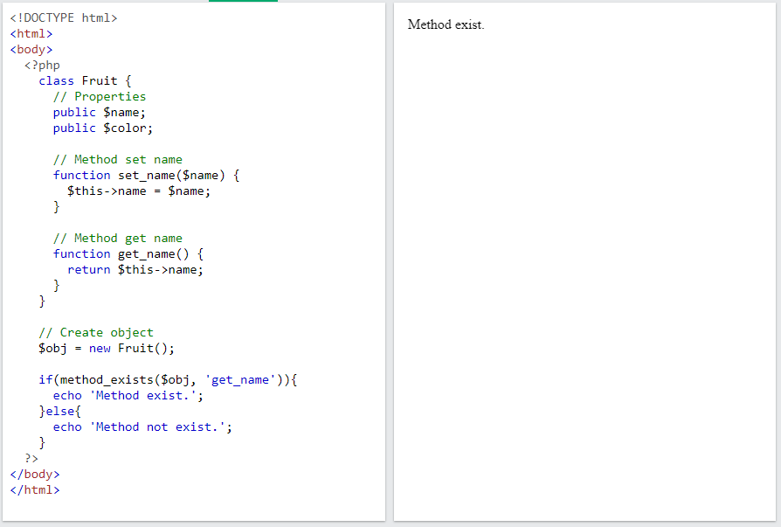
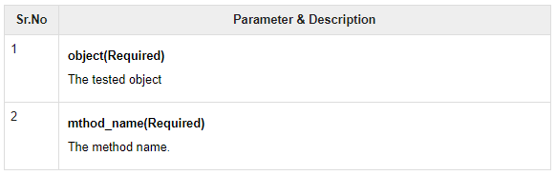
3 - PHP method_exists() Function
It checks if the class method exists in the given object. It returns TRUE if the method given by method_name has been defined for the given object, FALSE otherwise.

Slide 11
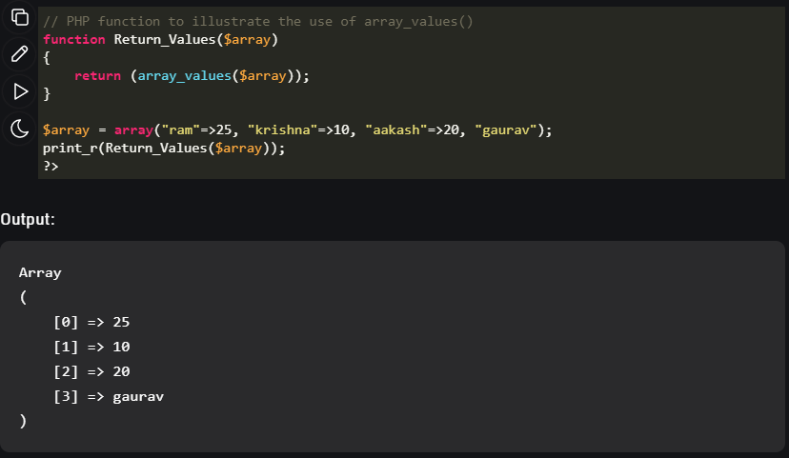
4 - PHP array_values() Function
The array_values() function returns an array containing all the values of an array. Tip: The returned array will have numeric keys, starting at 0 and increase by 1.

Slide 12

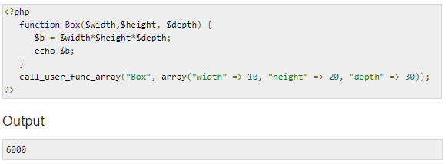
5 - call_user_func_array() Function
The call_user_func_array() function call a user function given with an array of parameters. The call_user_func_array() function can call a custom function "function" with the parameters from "param_arr array".

Slide 13
2 – Check Routing Rules from Previous Lecture

Slide 14
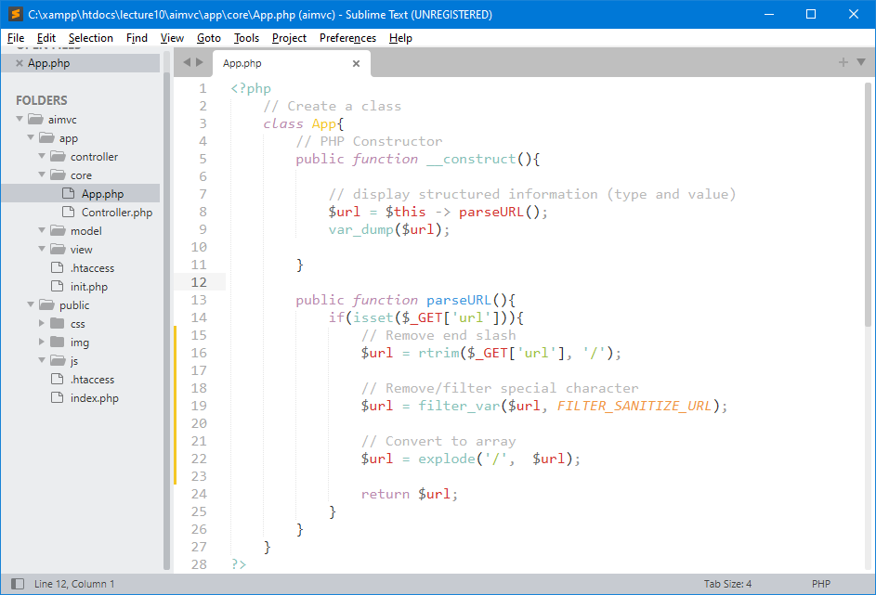
Handling Request URL
Handle more routing rules when users try to request through URL.

Slide 15
URL Routing
Typically there is a one-to-one relationship (hubungan satu-ke-satu) between a URL string and its corresponding controller class/method. The segments in a URL (bagian dalam URL) normally follow this pattern:
http:/www.example.com/class/method/parameter1/parameter2/
What is a Controller?
A Controller is simply a class file that is named in a way that can be associated with a URI.
Class merupakan controller class yang sudah dibuat dan biasanya segmen kedua (method) dari URL disiapkan untuk nama metode.
Notes:
https://codeigniter.com/userguide3/general/controllers.html

Slide 16
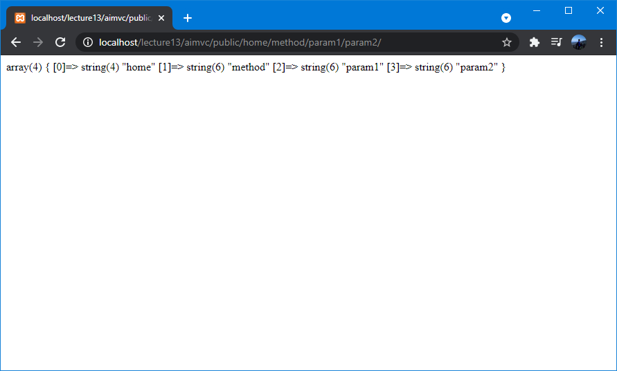
URI Routing from Previous Demo
Index[0]
Index[1]
Index[2]
Index[3]
Controller
Method
Parameter #1
Parameter #2
Our app starts from this directory location:
http://localhost/lecture13/aimvc/public/
This means Controller default (home) and method default (index).
URL Format: http://localhost/lecture13/aimvc/public/class/method/param1/param2/
Notes:
https://codeigniter.com/userguide3/general/controllers.html

Slide 17
3 – Create Classes
(Home & Project)
as Controller and Default Method

Slide 18
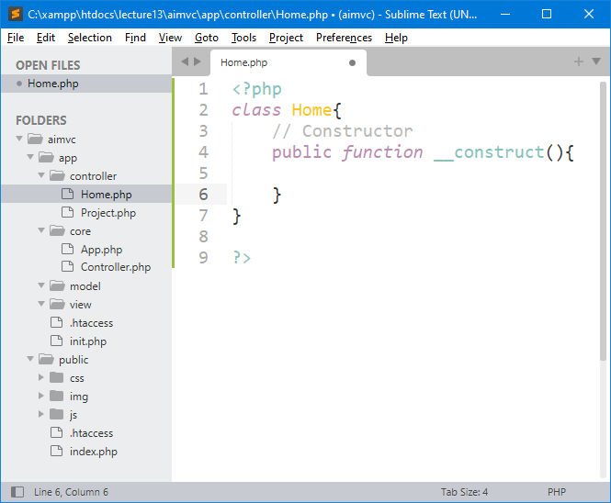
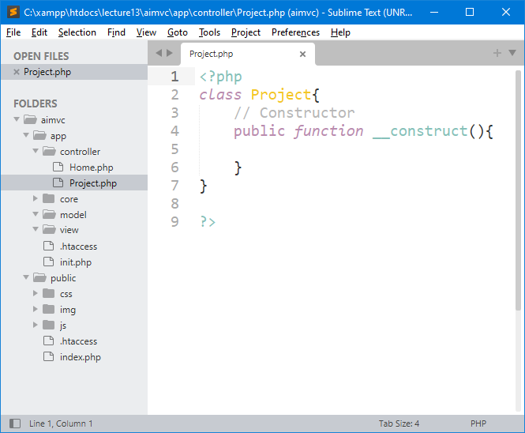
Controller Classes
Important Note:
Class names must start with an uppercase letter.
Create two classes in controller directory to represent/handle home and project pages in our framework.

Slide 19
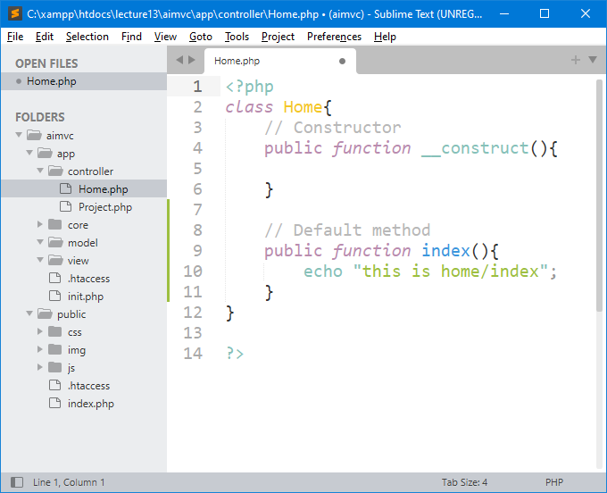
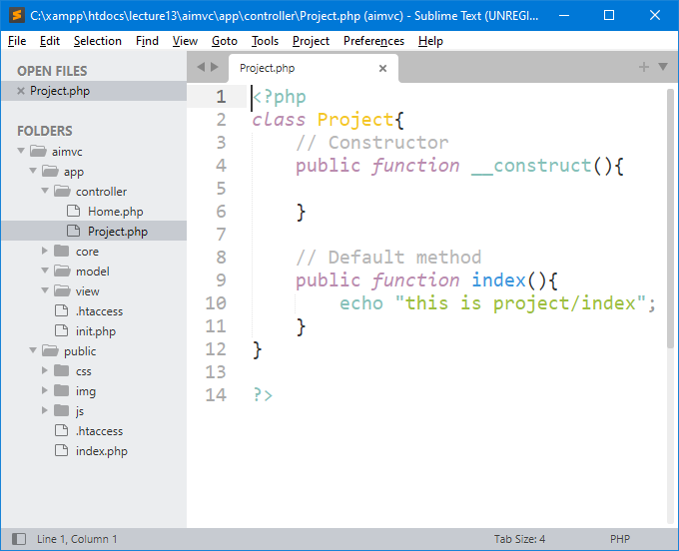
index() as a Default Method
When we do not write/request anything in the URL (“/aimvc/public/”), then this method (index) will be called.

Slide 20

__construct() vs index() methods
Why don't you just use the constructor instead of the index method?
__construct() is called first, then according to URL is called index() or other functions.
Public function __construct() should contain:
allocating resources used in entire class ex. $this->load
check user authentication (if entire class requires it)
Public function index() should contain:
allocating resources used only in this function
calling views or displaying anything
Link:
https://stackoverflow.com/questions/16691036/codeigniter-2-difference-between-index-and-construct-and-what-to-put-in-cons

Slide 21
4 – Handle URL Request with Controller Classes (home & project)

Slide 22
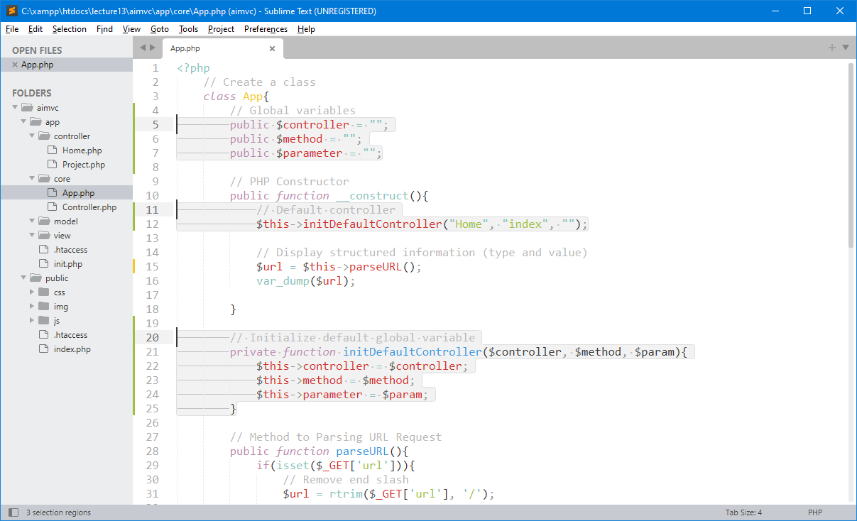
Create Global Variables
In PHP class, global variable as property in class to store a default controller (home).
Global variables

Slide 23
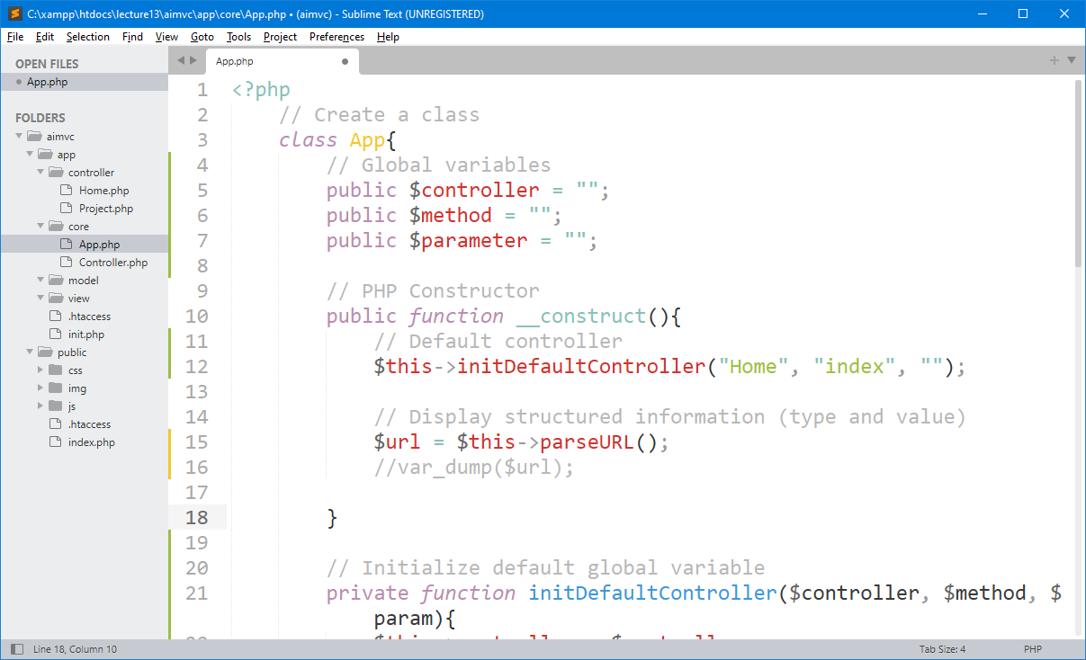
Remember this $url variable !!!
If the url request change, we can handle next request after this line of code.

Slide 24
After Add Some URI Routing Rules
Index[0]
Index[1]
Index[2]
Index[3]
Controller
Method
Parameter #1
Parameter #2
Our app starts from this directory location:
http://localhost/lecture13/aimvc/public/
This means Controller default (home) and method default (index).
URL Format: http://localhost/lecture13/aimvc/public/home/method/param1/param2/
Notes:
https://codeigniter.com/userguide3/general/controllers.html

Slide 25
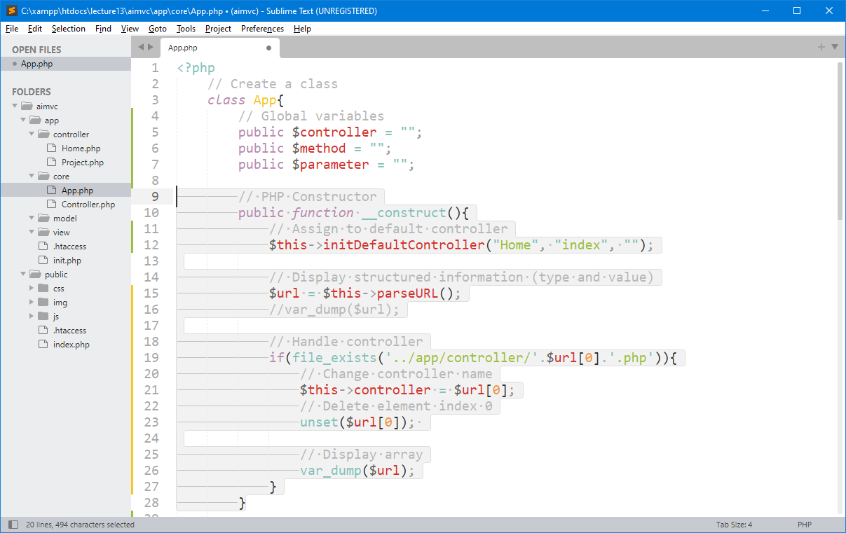
Get element index 0 as Controller Name
Check if specific controller class file exist in controller directory or not.

Slide 26
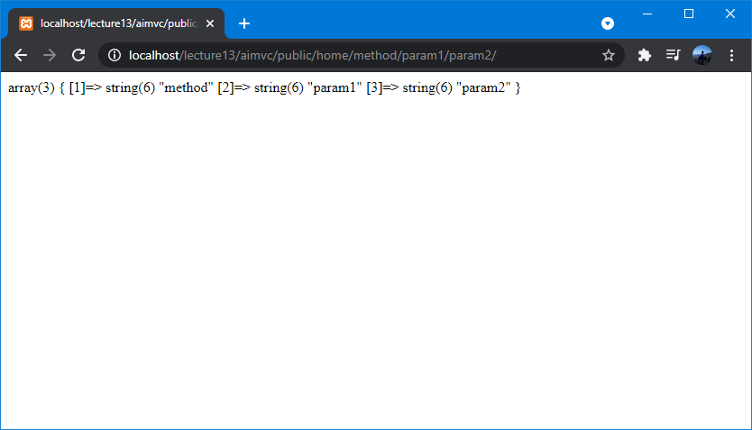

Recognize Controller Name
There’s no index 0 after var_dump()?
Element of index 0 (value: home) already recognized as a controller class name.

Slide 27
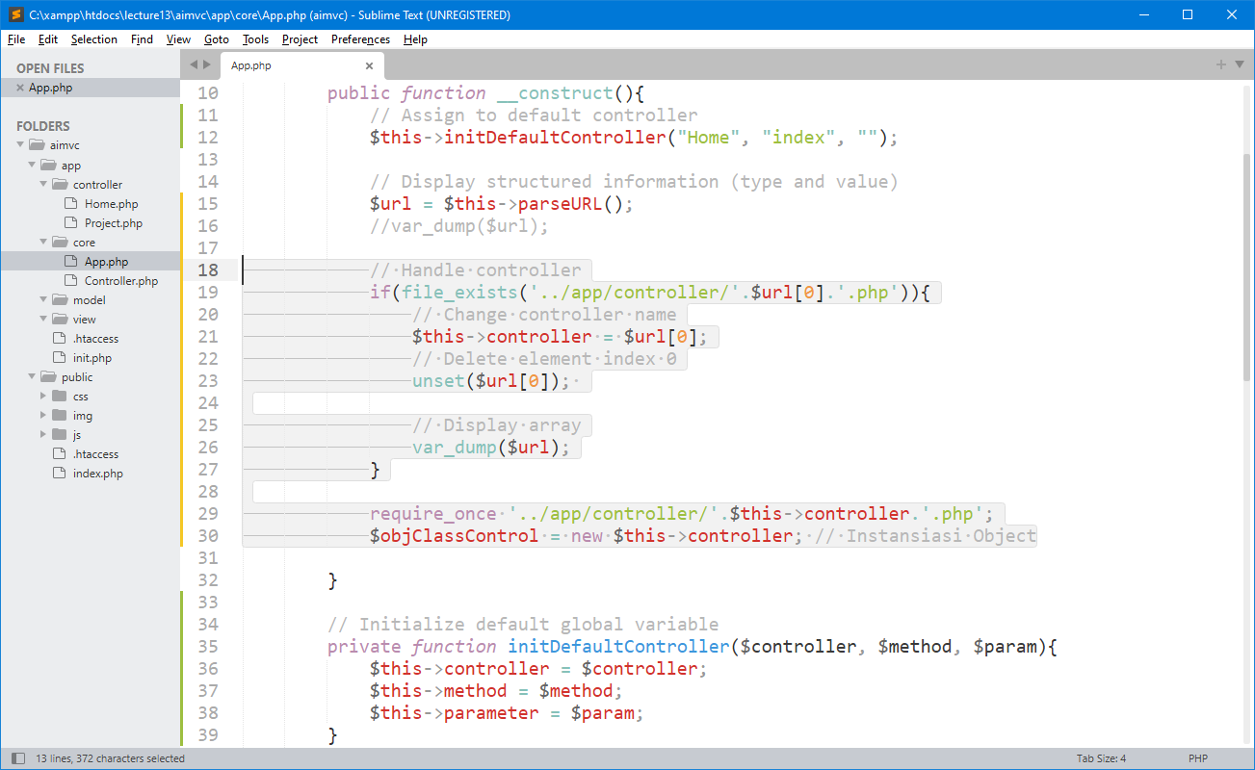
Full Handle Controller
After get controller name in controller directory, you can create an object based on controller class that you already included.

Slide 28
5 – Handle URL Request with
Method and Default Method

Slide 29
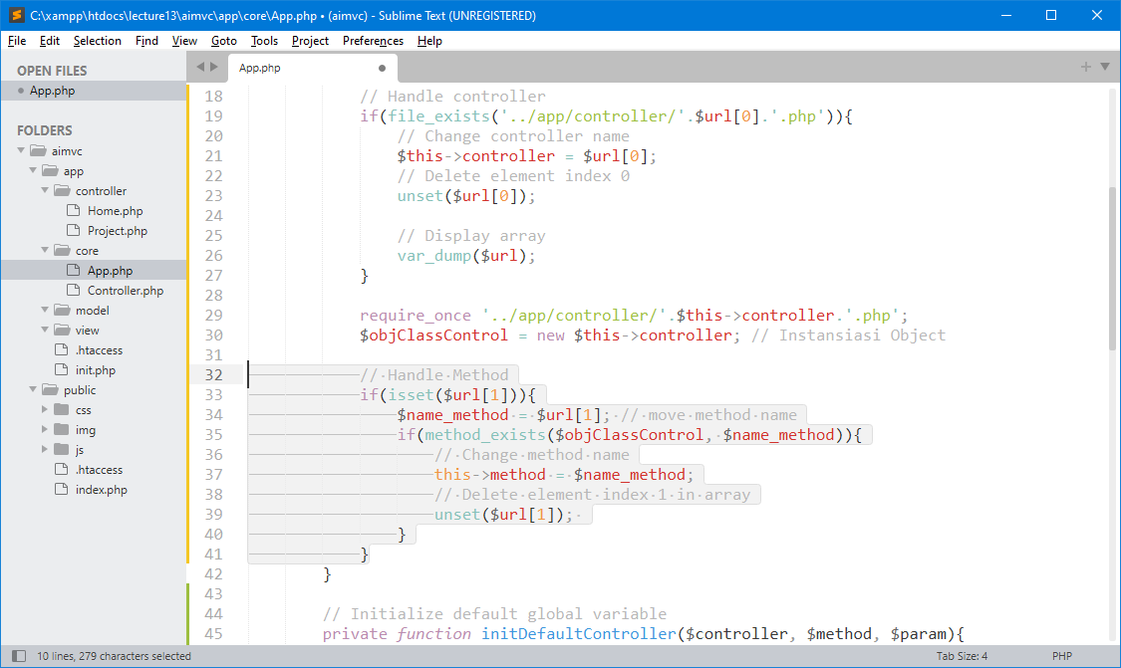
Recognize Method Name (default or not)
Array index in url[1] contains method name from input request url. After checking the existence of method, this system can decide to output default method or not.

Slide 30
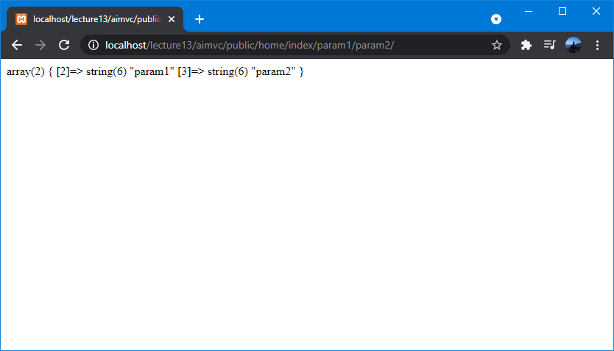
Test Handle Method
Index[2]
Index[3]
Parameter #1
Parameter #2
Element of index 1 (value: index) already recognized as a default method name (index).

Slide 31
6 – Handle URL Request with
Parameter

Slide 32
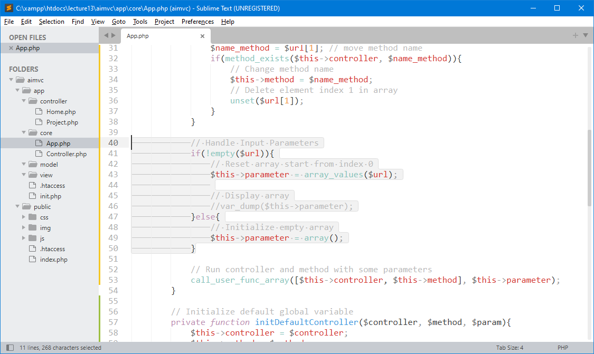
Recognize Input Parameters
Check whether the remaining array still exists or not. If yes, then it must be reset started from index 0.

Slide 33

Test Handle Input Parameters
Index[0]
Index[1]
Parameter #1
Parameter #2
All elements in the array containing the "parameters" have been reset and are now stored in global variables.

Slide 34
7 – Finalize URL Request
[run controller & method with parameters]

Slide 35
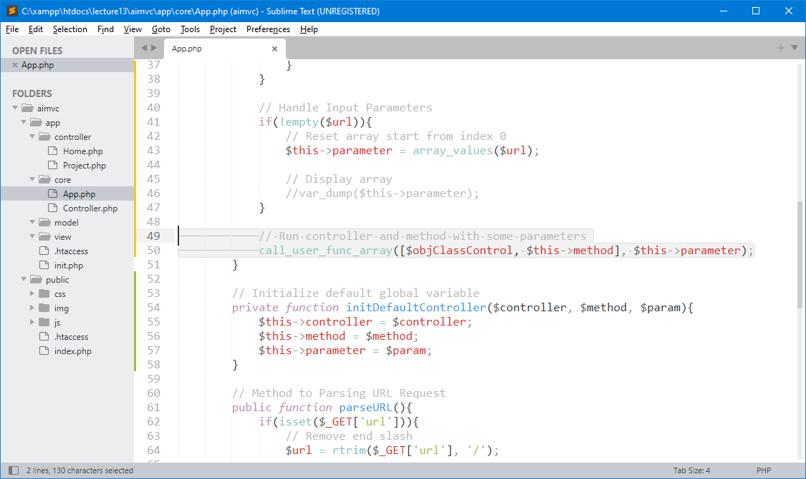
Run controller & method

Slide 36
8 – Testing

Slide 37
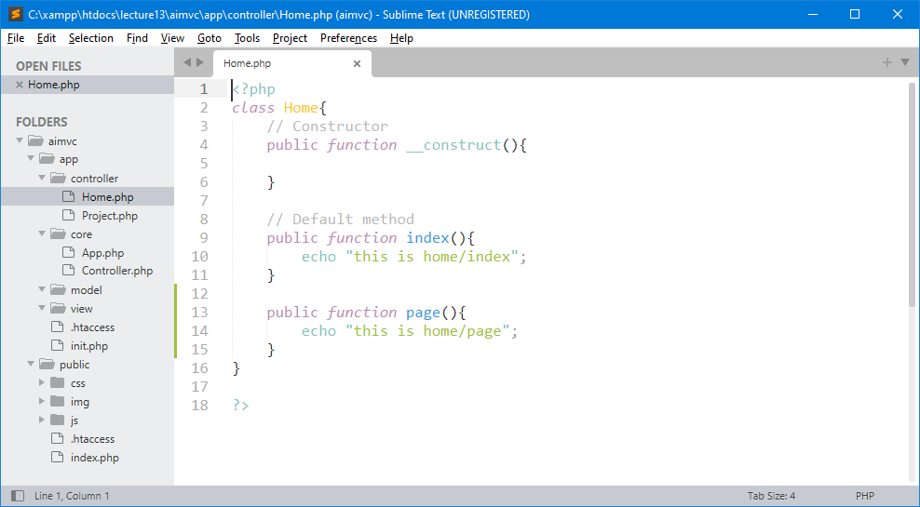
Add More Methods

Slide 38
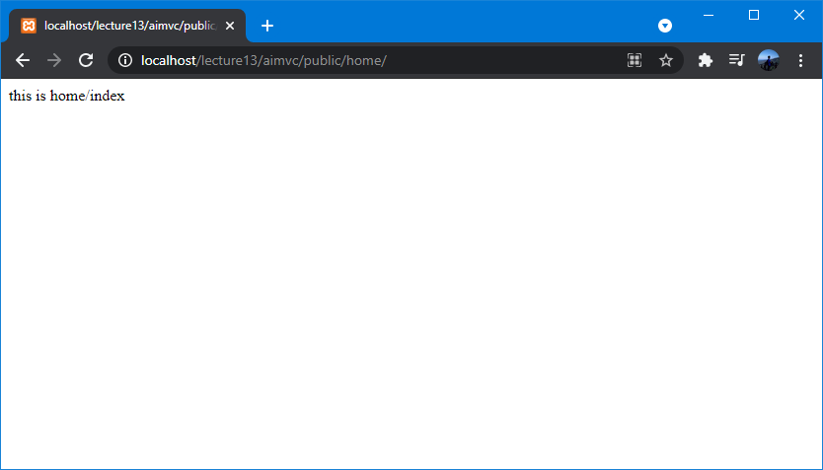
Access Home Controller (index)

Slide 39
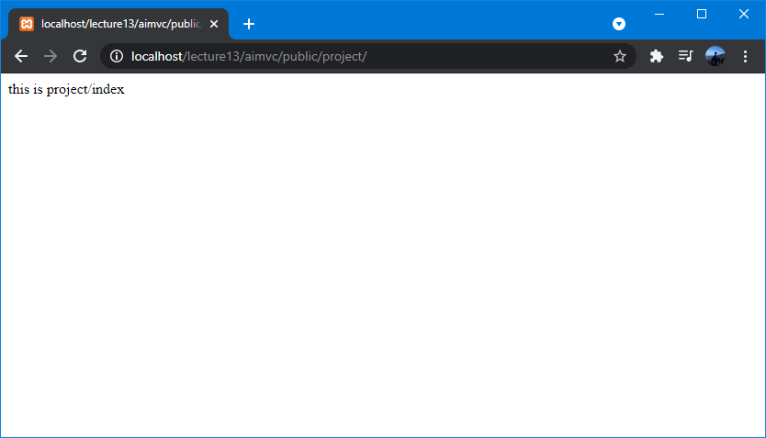
Access Project Controller (index)

Slide 40
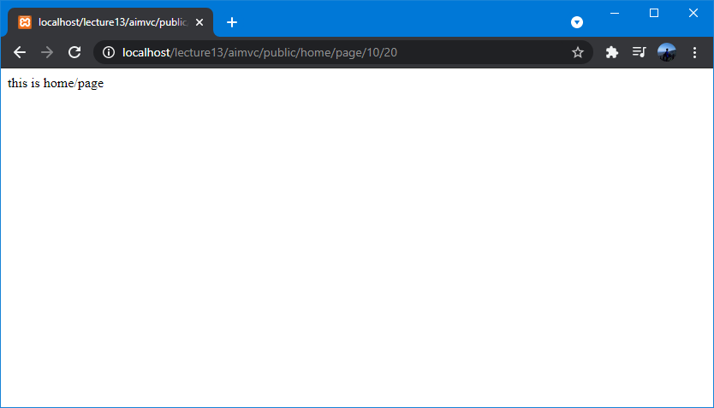
Access Home Controller with Specific Method

Slide 41

exercise for students

Slide 42
Latihan untuk Students
Create directory : C:\xampp\htdocs\lecture13\
Create file : _.php
Buat semua contoh yang sudah di pelajari sebelumnya.

Slide 43
Reference (#1)
Controllers
https://codeigniter.com/userguide3/general/controllers.html#id1
URI Routing
https://codeigniter.com/userguide3/general/routing.html
Model View Controller example
https://developer.mozilla.org/en-US/docs/Glossary/MVC
Learn About MVC Architecture
https://www.c-sharpcorner.com/article/learn-about-mvc-architecture/
MVC URL Routing
https://sudhersonv.wixsite.com/codeblogs/single-post/2015/05/19/mvc-url-routing
Model View Controller Pattern – MVC Architecture and Frameworks
https://www.freecodecamp.org/news/the-model-view-controller-pattern-mvc-architecture-and-frameworks-explained/
Apa itu MVC? Mengenal Mvc (Model View Controller)
https://note-ade.blogspot.com/2020/10/mvc.html
Sistem Pemrograman Model View Controller (MVC)
https://informatika.uc.ac.id/id/2016/12/sistem-pemrograman-model-view-controller-mvc/
A Beginner's guide to Ruby on Rails MVC
https://hackernoon.com/beginners-guide-to-ruby-on-rails-mvc-model-view-controller-pattern-4z19196a

Slide 44
THANK YOU
END PRESENTATION
Thank you for your attention
Instructor: S – W – T

